Slide 1

GovTech – System architecture Diagram

Slide 2
Problem Statement :
You are designing data infrastructure on the cloud for a company whose main business is in processing images.
The company has a web application which collects images uploaded by customers. The company also has a separate web application which provides a stream of images using a Kafka stream. The company’s software engineers have already some code written to process the images. The company would like to save processed images for a minimum of 7 days for archival purposes. Ideally, the company would also want to be able to have some Business Intelligence (BI) on key statistics including number and type of images processed, and by which customers.
Produce a system architecture diagram (e.g. Visio, Powerpoint) using any of the commercial cloud providers' ecosystem to explain your design. Please also indicate clearly if you have made any assumptions at any point
Assumptions:
Sourced images are stored in the Binary Large Object in the cloud of preferred cloud service providers such as Azure, AWS or GCP.
Metadata specific to image also ingested in the form of JSON or tabular format into Organization’s Date Warehouse/Data Hub etc.
Along with metadata, other information specific to customer also flows to Data Warehouse/Data Hub etc.
Stage layer will be used to store data in the source format.
Detail Layer stores cleansed, standardized, enriched data in modeled format
Mart or semantic layer stores summary data for end use consumption.
Note:

Slide 3









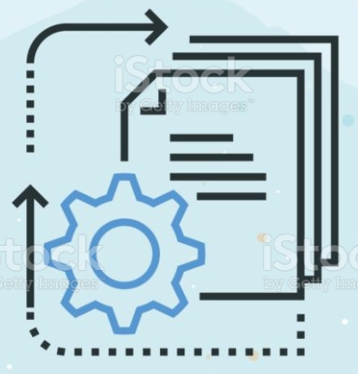






System Architecture Diagram
Data Platform
(Lambda & Data Lake Architecture)
Data Source
Data Ingestion
Processing
BI Solutions
Stream
Processing
Raw/staging
Data
Modeled
detail data
Analytics
Data Mart
Data
Visualization
Data Lake
Processed
Files
Raw
Files
Applications
ETL/ELT thru
JDBC/ODBC
AWS S3/Azure/GCP Storage
Batch
Processing
Web Application
Security
Catalog & Discovery
Lineage

